Slide 1
Introduction to Micro Service Architecture

Slide 2
Monolithic Architecture
In layman terms, you can say that its similar to a big container wherein all the software components of an application are assembled together and tightly packaged.

Slide 3
Challenges of Monolithic Architecture
Not Fit for Complex Applications
Features of complex applications have tightly coupled dependencies.
Blocks Continous Development
Many features of the applications cannot be built and deployed at the same time.
Slow Development
Development in monolithic applications take lot of time to be built since each and every feature has to be built one after the other.
Unscalable
Applications cannot be scaled easily since each time the application needs to be updated, the complete system has to be rebuilt.
Unreliable
Even if one feature of the system does not work, then the entire system does not work.
Inflexible
Monolithic applications cannot be built using different technologies.
Notes:
The above challenges were the main reasons that led to the evolution of microservices. So, now let us understand what is Microservices in simple words?

Slide 4
What exactly is Micro Services?
Micro Services is an architectural style that structures an application as a collection of small autonomous services, modeled around a business domain.

Slide 5
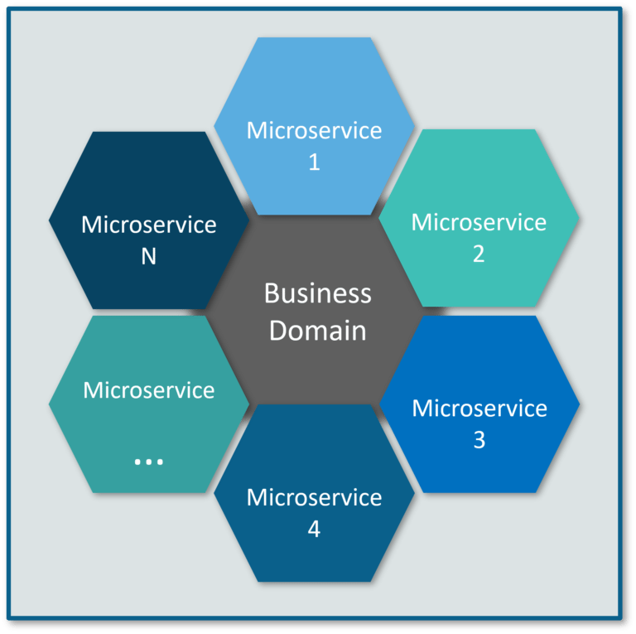
What exactly is Micro Services?
In the given Architecture, each service is self-contained and implements a single business capability.
Figure 1: Micro Services Representation

Slide 6
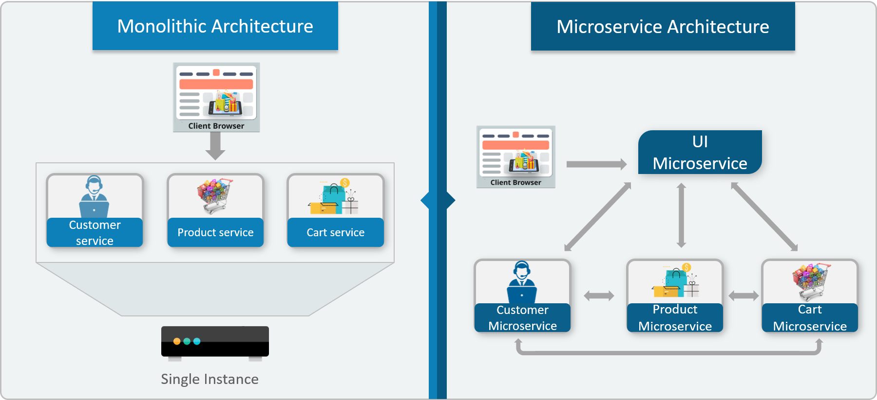
Differences Between Traditional Architecture and Micro Services
Figure 2: Difference Between Traditional Architecture and Micro Services
Notes:
Consider an E-commerce application as a use-case to understand the difference between both of them.
The main difference we observe in the above diagram is that all the features initially were under a single instance sharing a single database. But then, with microservices, each feature was allotted a different microservice, handling their own data, and performing different functionalities.

Slide 7
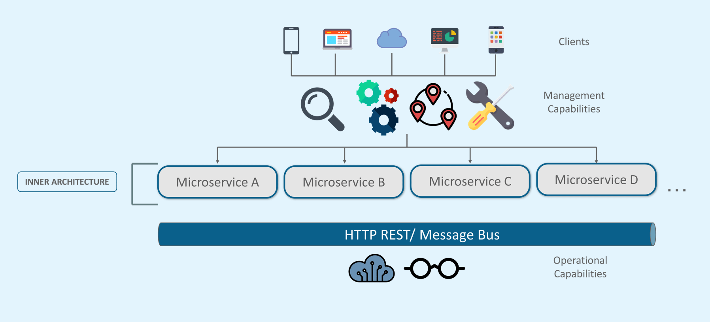
Architecture of Micro Services
Figure 3: Architecture
Notes:
* Different clients from different devices try to use different services like search, build, configure and other management capabilities
* All the services are separated based on their domains and functionalities and are further allotted to individual microservices
* These microservices have their own load balancer and execution environment to execute their functionalities & at the same time captures data in their own databases
* All the microservices communicate with each other through a stateless server which is either REST or Message Bus
* Microservices know their path of communication with the help of Service Discovery and perform operational capabilities such as automation, monitoring
* Then all the functionalities performed by microservices are communicated to clients via API Gateway
* All the internal points are connected from the API Gateway. So, anybody who connects to the API Gateway automatically gets connected to the complete system

Slide 8
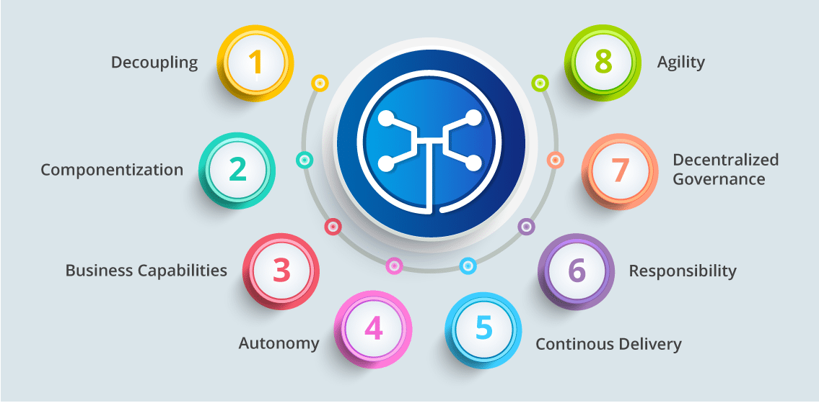
Micro Services Feature
Figure 4: Features
Notes:
* Decoupling – Services within a system are largely decoupled. So the application as a whole can be easily built, altered, and scaled
* Componentization – Microservices are treated as independent components that can be easily replaced and upgraded
* Business Capabilities – Microservices are very simple and focus on a single capability
* Autonomy – Developers and teams can work independently of each other, thus increasing speed
* Continuous Delivery – Allows frequent releases of software, through systematic automation of software creation, testing, and approval
* Responsibility – Microservices do not focus on applications as projects. Instead, they treat applications as products for which they are responsible
* Decentralized Governance – The focus is on using the right tool for the right job. That means there is no standardized pattern or any technology pattern. Developers have the freedom to choose the best useful tools to solve their problems
* Agility – Any new feature can be quickly developed and discarded again

Slide 9
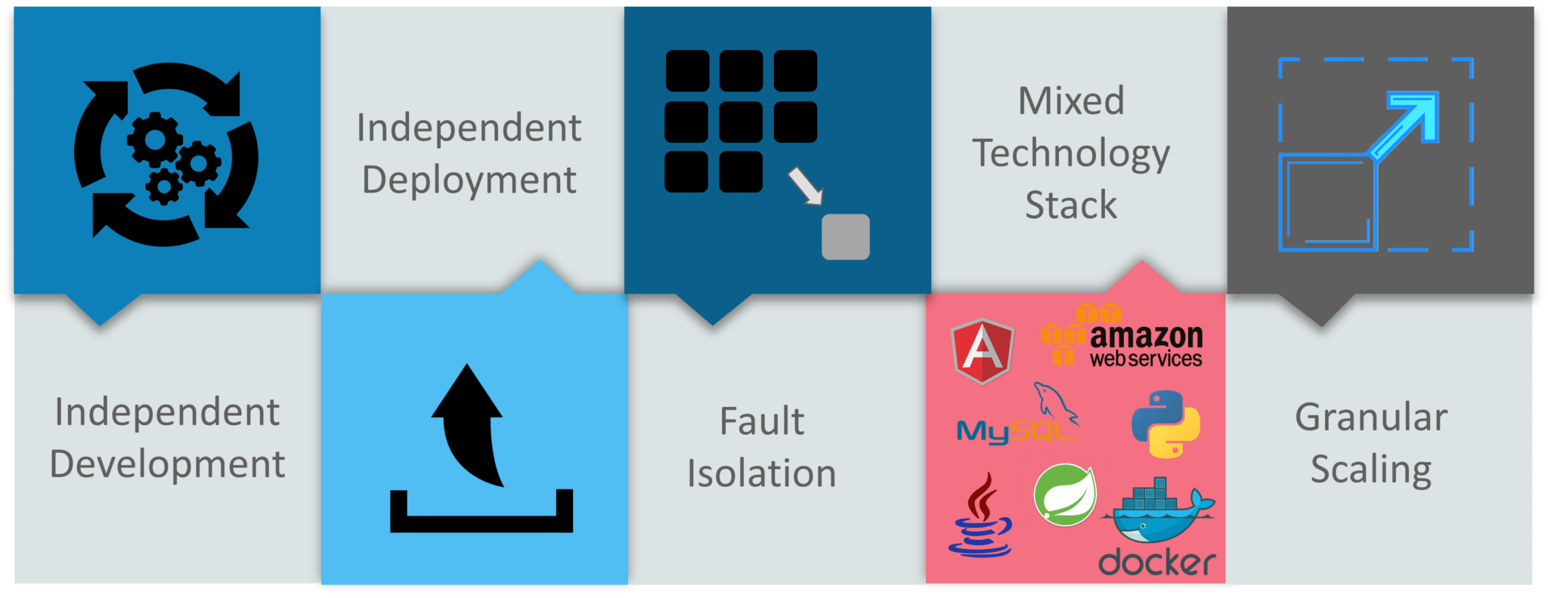
Advantages of Micro Services
Figure 5: Advantages
Notes:
* Independent Development – All microservices can be easily developed based on their individual functionality
* Independent Deployment – Based on their services, they can be individually deployed in any application
* Fault Isolation – Even if one service of the application does not work, the system still continues to function
* Mixed Technology Stack – Different languages and technologies can be used to build different services of the same application
* Granular Scaling – Individual components can scale as per need, there is no need to scale all components together

Slide 10
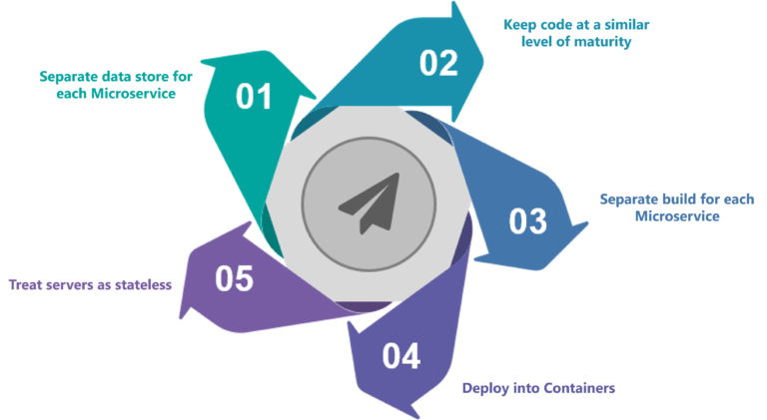
What are the Best Practices to Design Micro Services?
Figure 6: Best Practices to Design Micro Services
Notes:
In today’s world, complexity has managed to creep into products. Microservice architecture promises to keep teams scaling and function better.

Slide 11
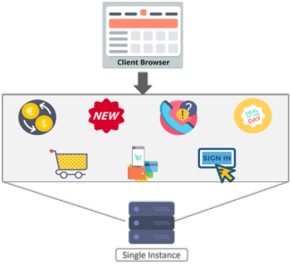
Monolithic Example: Shopping Cart Application
Figure 7: Monolithic Framework of Shopping Cart Application
Notes:
* Let’s take a classic use case of a shopping cart application.
* When you open a shopping cart application, all you see is just a website. But, behind the scenes, the shopping cart application has a service for accepting payments, a service for customer services and so on.
* Assume that developers of this application have created it in a monolithic framework. Refer to Figure 7:
- So, all the features are put together in a single code base and are under a single underlying database.

Slide 12
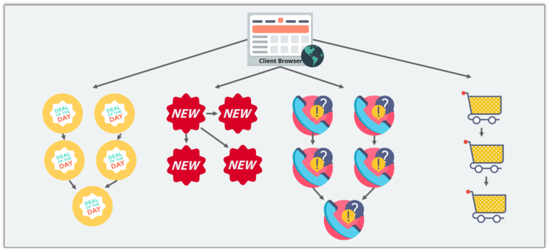
Micro Service Example: Shopping Cart Application
Figure 8: Micro Service Framework of Shopping Cart Application
Notes:
* Now, let’s suppose that there is a new brand coming up in the market and developers want to put all the details of the upcoming brand in this application.
* Then, they not only have to rework on the service for new labels, but they also have to reframe the complete system and deploy it accordingly.
* To avoid such challenges developers of this application decided to shift their application from a monolithic architecture to a newer architecture. Refer to the Figure 8 to understand the architecture of shopping cart application
* This means that developers don’t create a web micro service, a logic micro service, or a database micro service. Instead, they create separate microservices for search, recommendations, customer services and so on.
* This type of architecture for the application not only helps the developers to overcome all the challenges faced with the previous architecture but also helps the shopping cart application to be built, deployed, and scale up easily.

Slide 13
Spring Boot

Slide 14
What is Spring Boot?
Spring Boot is an open source Java-based framework used to create a Micro Service. It is developed by Pivotal Team.
It is easy to create a stand-alone and production ready spring applications using Spring Boot.
Spring Boot contains a comprehensive infrastructure support for developing a micro service and enables you to develop enterprise-ready applications that you can “just run”.

Slide 15
Bootstrapping
One of the ways to Bootstrapping a Spring Boot application is by using Spring Initializer. To do this, you will have to visit the Spring Initializer web page https://start.spring.io and choose your Build, Spring Boot Version and platform.
Also, you need to provide a Group, Artifact and required dependencies to run the application.

Slide 16
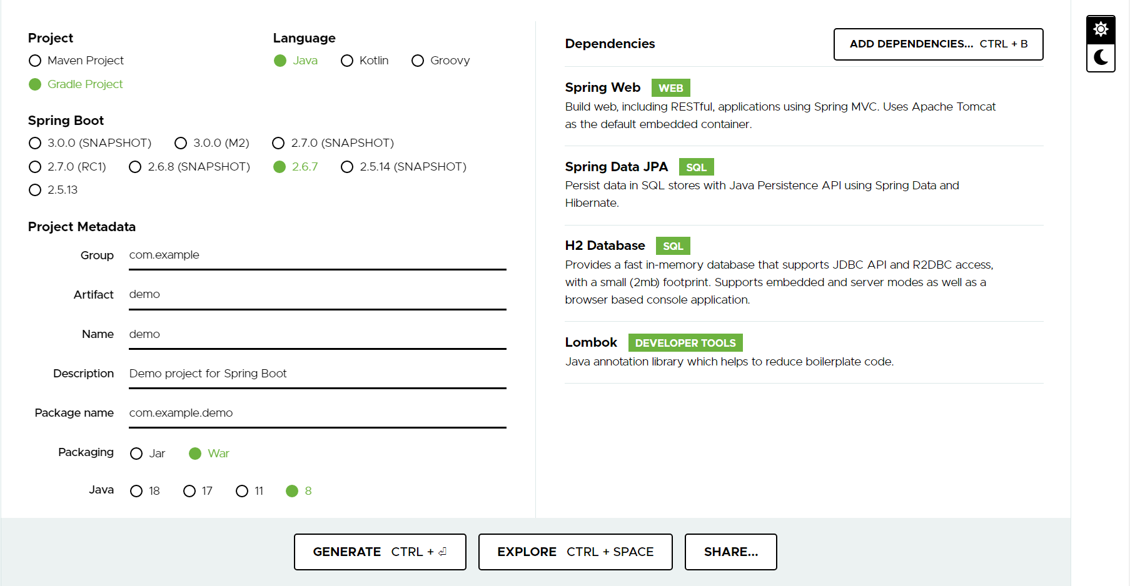
Bootstrapping

Slide 17
Main Method
The main method should be writing the Spring Boot Application class. This class should be annotated with @SpringBootApplication.
This is the entry point of the spring boot application to start. You can find the main class file under src/java/main directories with the default package.

Slide 18
Write a REST Endpoint
To write a simple Hello World Rest Endpoint in the Spring Boot Application main class file itself, follow the steps shown below.
1. First, add the @RestController annotation at the top of the class
2. Now, write a Request URI method with @GetMapping(“/”) annotation
3. Then, the Request URI method should return the Hello World string.
Notes:
Run via IntelliJ, then access http://localhost:8080/

Slide 19
Tomcat Deployment
Using Gradle (global):
Run “gradle clean build” in Git Bash
Using Gradle Wrapper:
In project’s working directory, run “./gradlew clean build” in Git Bash
- The exported project (war file) should be located in <project>/build/libs/ directory

Slide 20
Code Structure
Spring Boot does not have any code layout to work with. However, there are some best practices that will help us.
Typical Layout:
+- com.example.demo
+- DemoApplication.java
+- model
Product.java
+- dao
ProductRepository.java
+- controller
ProductController.java
+- service
ProductService.java
ProductServiceImpl.java

Slide 21
Spring Beans & Dependency Injection
In Spring Boot, we can use Spring Framework to define our beans and their dependency injection. The @ComponentScan annotation is used to find beans and the corresponding injected with @Autowired annotation.
If you followed the Spring Boot typical layout, no need to specify any arguments for @ComponentScan annotation. All component class files are automatically registered with Spring Beans.

Slide 22
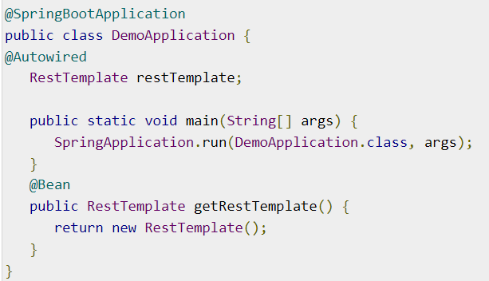
Spring Beans & Dependency Injection

Slide 23
Runners
Application Runner and Command Line Runner interfaces lets you to execute the code after the Spring Boot application is started.
You can use these interfaces to perform any actions immediately after the application has started.

Slide 24
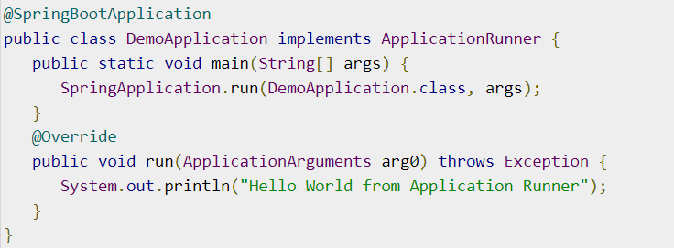
Application Runner
Application Runner is an interface used to execute the code after the Spring Boot application started.

Slide 25
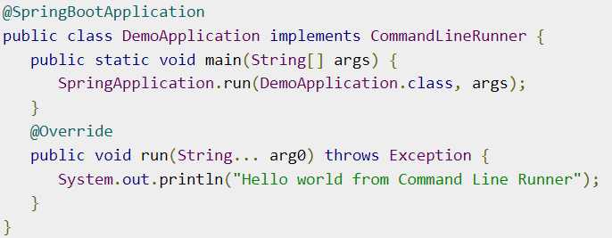
Command Line Runner
Command Line Runner is an interface. It is used to execute the code after the Spring Boot application started.

Slide 26

Application Properties
Properties files are used to keep ‘N’ number of properties in a single file to run the application in a different environment.
In Spring Boot, properties are kept in the application.properties file under the classpath.
The application.properties file is located in the src/main/resources directory.

Slide 27
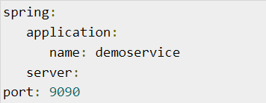
Application Properties
Spring Boot supports YAML based properties configurations to run the application.
Instead of application.properties, we can use application.yml file.
This YAML file also should be kept inside the classpath.

Slide 28
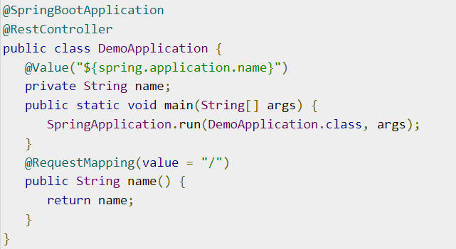
Use of @Value Annotation
The @Value annotation is used to read the environment or application property value in Java code.

Slide 29
Spring Boot Active Profile
Spring Boot supports different properties based on the Spring active profile.
For example, we can keep two separate files for development and production to run the Spring Boot application.

Slide 30
Spring Active Profile for application.yml
We can keep the Spring active profile properties in the single application.yml file.
Note that the delimiter (---) is used to separate each profile in application.yml file.

Slide 31
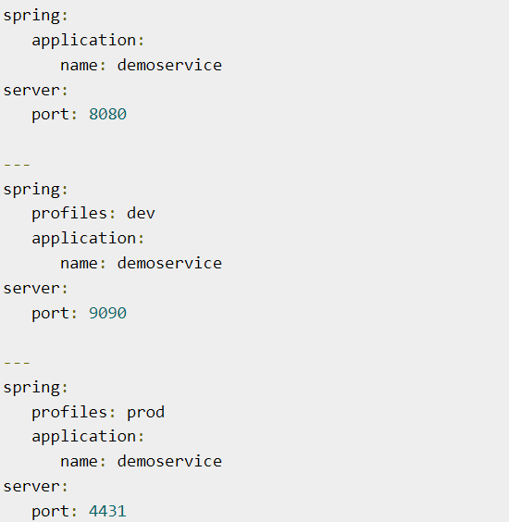
Spring Active Profile for application.yml

Slide 32
Logging
Spring Boot uses Apache Commons logging for all internal logging. Spring Boot’s default configurations provides a support for the use of Java Util Logging, Log4j2, and Logback. Using these, we can configure the console logging as well as file logging.
If you are using Spring Boot Starters, Logback will provide a good support for logging. Besides, Logback also provides a use of good support for Common Logging, Util Logging, Log4J, and SLF4J.

Slide 33
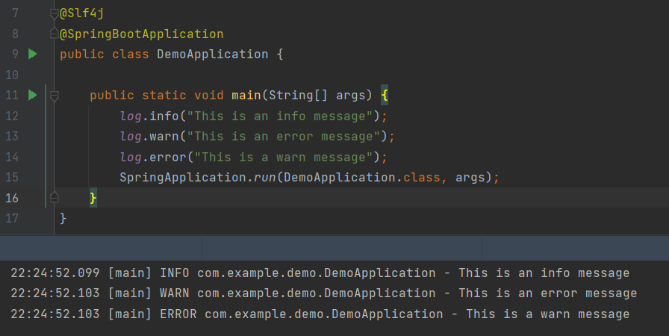
Logging

Slide 34
Building RESTful Web Service
Spring Boot provides a very good support to building RESTful Web Services for enterprise applications.
Note − For building a RESTful Web Services, we need to add the Spring Boot Starter Web dependency into the build configuration file.

Slide 35
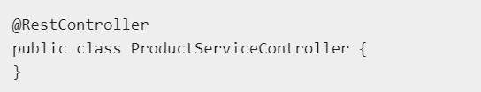
Rest Controller
The @RestController annotation is used to define the RESTful web services. It serves JSON, XML and custom response.

Slide 36

Request Mapping
The @RequestMapping annotation is used to define the Request URI to access the REST Endpoints.
We can define Request method to consume and produce object. The default request method is GET.

Slide 37
Request Body
The @RequestBody annotation is used to define the request body content type.

Slide 38
Path Variable
The @PathVariable annotation is used to define the custom or dynamic request URI.
The Path variable in request URI is defined as curly braces {}

Slide 39
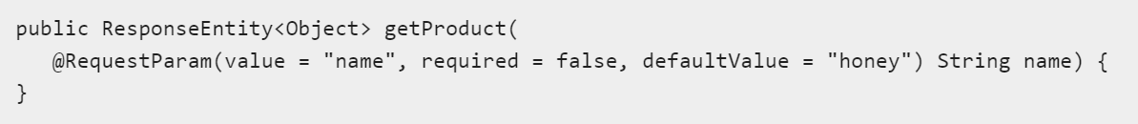
Request Parameter
The @RequestParam annotation is used to read the request parameters from the Request URL.
By default, it is a required parameter.
We can also set default value for request parameters

Slide 40
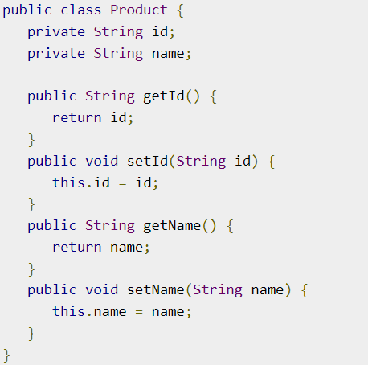
POJO Class - (Plain Old Java Object)

Slide 41
GET API
The default HTTP request method is GET. This method does not require any Request Body. You can send request parameters and path variables to define the custom or dynamic URL.
The sample code to define the HTTP GET request method is shown below. In this example, we used HashMap to store the Product. Note that we used a POJO class as the product to be stored.
Here, the request URI is /products and it will return the list of products from HashMap repository. The controller class file is given below that contains GET method REST Endpoint.

Slide 42
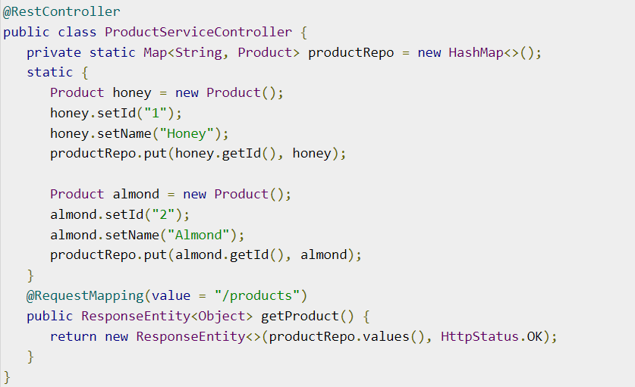
GET API

Slide 43
POST API
The HTTP POST request is used to create a resource. This method contains the Request Body. We can send request parameters and path variables to define the custom or dynamic URL.
The following example shows the sample code to define the HTTP POST request method. In this example, we used HashMap to store the Product, where the product is a POJO class.
Here, the request URI is /products, and it will return the String after storing the product into HashMap repository.

Slide 44
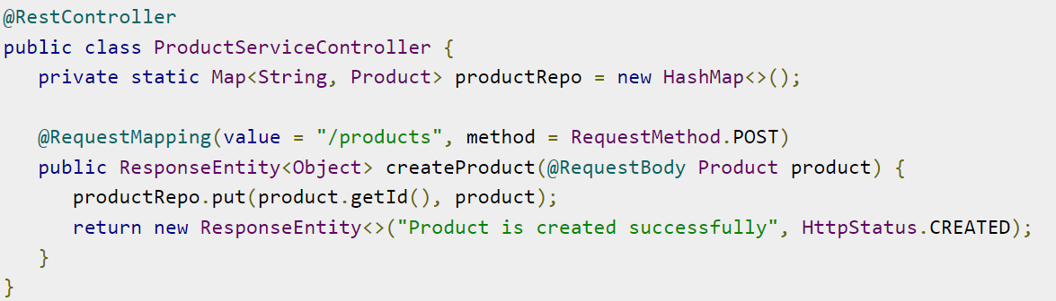
POST API

Slide 45
PUT API
The HTTP PUT request is used to update the existing resource. This method contains a Request Body. We can send request parameters and path variables to define the custom or dynamic URL.
The example given below shows how to define the HTTP PUT request method. In this example, we used HashMap to update the existing Product, where the product is a POJO class.
Here the request URI is /products/{id} which will return the String after a the product into a HashMap repository. Note that we used the Path variable {id} which defines the products ID that needs to be updated.

Slide 46
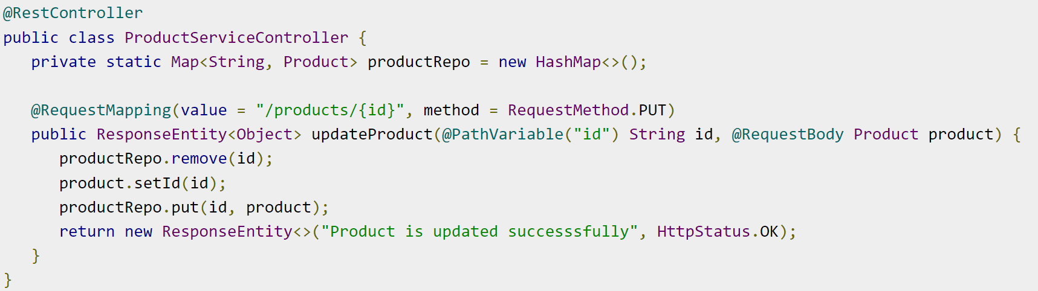
PUT API

Slide 47
DELETE API
The HTTP Delete request is used to delete the existing resource. This method does not contain any Request Body. We can send request parameters and path variables to define the custom or dynamic URL.
The example given below shows how to define the HTTP DELETE request method. In this example, we used HashMap to remove the existing product, which is a POJO class.
The request URI is /products/{id} and it will return the String after deleting the product from HashMap repository. We used the Path variable {id} which defines the products ID that needs to be deleted.

Slide 48
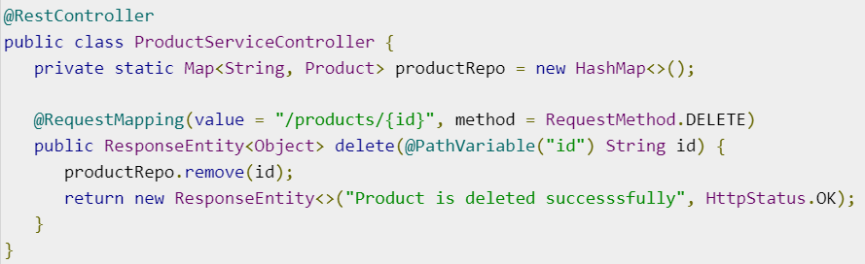
DELETE API

Slide 49
Exception Handling
Handling exceptions and errors in APIs and sending the proper response to the client is good for enterprise applications.

Slide 50

Controller Advice
The @ControllerAdvice is an annotation, to handle the exceptions globally.

Slide 51

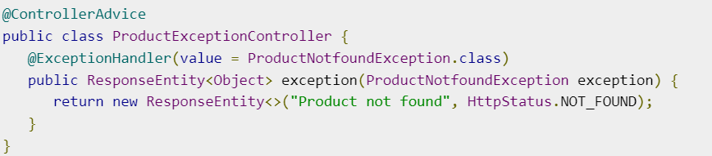
Exception Handler
The @ExceptionHandler is an annotation used to handle the specific exceptions and sending the custom responses to the client.

Slide 52
Interceptor
You can use the Interceptor in Spring Boot to perform operations under the following situations:
1. Before sending the request to the controller
2. Before sending the response to the client
For example, you can use an interceptor to add the request header before sending the request to the controller and add the response header before sending the response to the client.
To work with interceptor, you need to create @Component class that supports it and it should implement the HandlerInterceptor interface.

Slide 53
Interceptor
The following are the three methods you should know about while working on Interceptors:
preHandle() method − This is used to perform operations before sending the request to the controller. This method should return true to return the response to the client.
postHandle() method − This is used to perform operations before sending the response to the client.
afterCompletion() method − This is used to perform operations after completing the request and response.

Slide 54
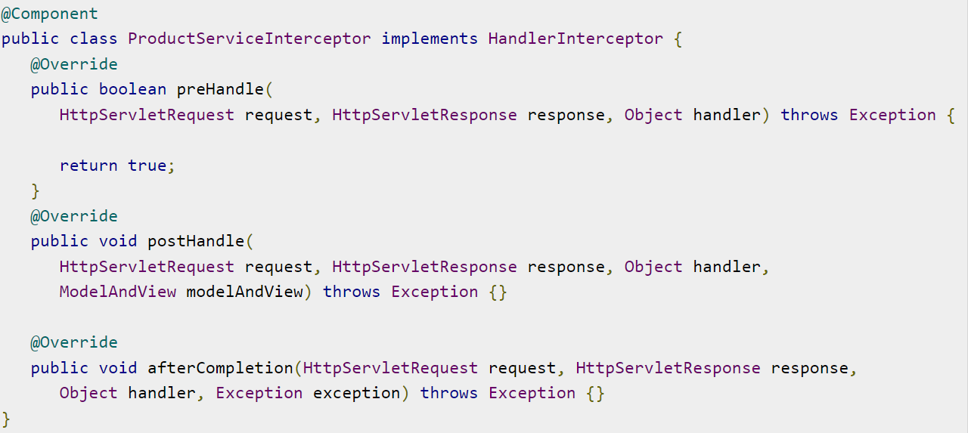
Interceptor

Slide 55
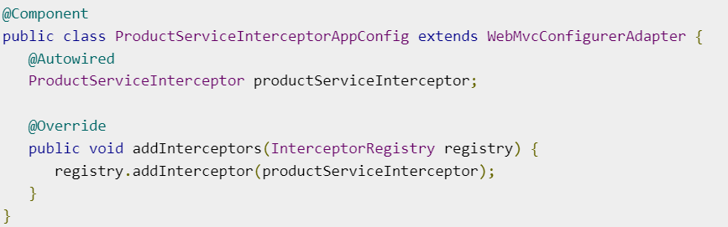
Interceptor
You will have to register this Interceptor with InterceptorRegistry by using WebMvcConfigurerAdapter as shown below:

Slide 56
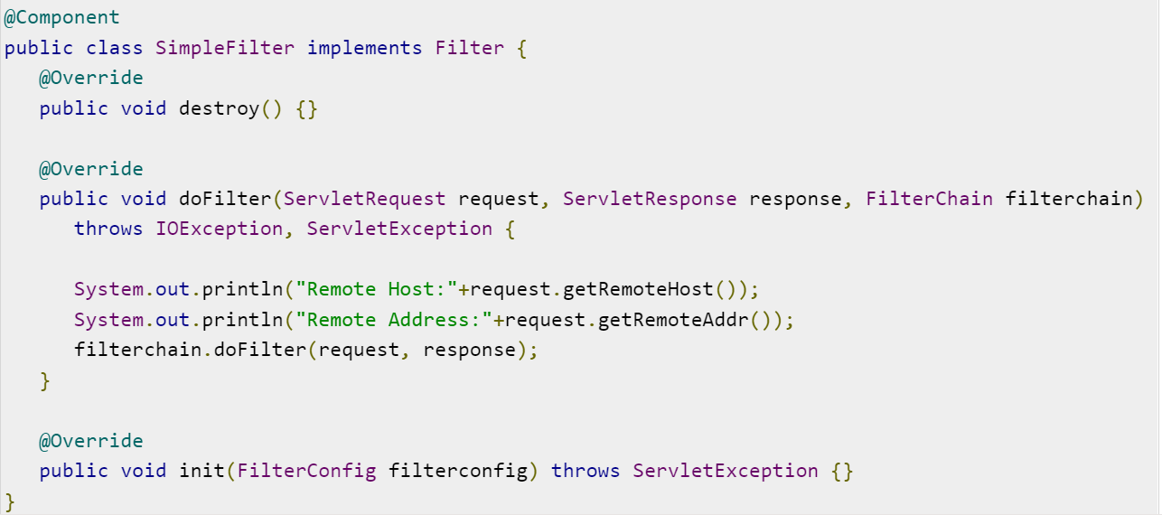
Servlet Filter
A filter is an object used to intercept the HTTP requests and responses of your application. By using filter, we can perform two operations at two instances:
1. Before sending the request to the controller
2. Before sending a response to the client.
Notes:
* The following example shows the code for reading the remote host and remote address from the ServletRequest object before sending the request to the controller.
* In doFilter() method, we have added the System.out.println statements to print the remote host and remote address.

Slide 57
Spring Boot Bean Validation

Slide 58
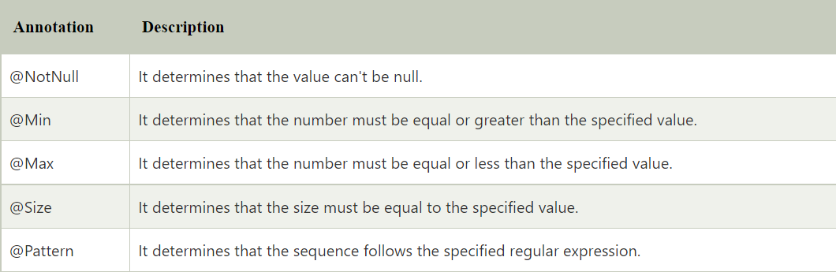
Bean Validation API
The Bean Validation API is a Java specification which is used to apply constraints on object model via annotations. Here, we can validate a length, number, regular expression, etc. Apart from that, we can also provide custom validations.
As Bean Validation API is just a specification, it requires an implementation. So, for that, it uses Hibernate Validator. The Hibernate Validator is a fully compliant JSR-303/309 implementation that allows to express and validate application constraints.

Slide 59
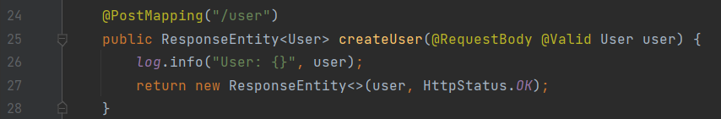
Bean Validation API
implementation 'org.springframework.boot:spring-boot-starter-validation'
Controller Layer - @Valid

Slide 60
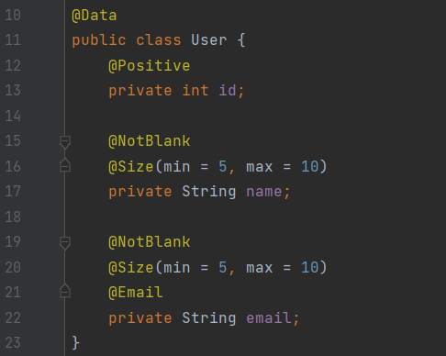
Bean Validation API
POJO Class
- @Positive
- @NotBlank
- @Size
- @Email

Slide 61
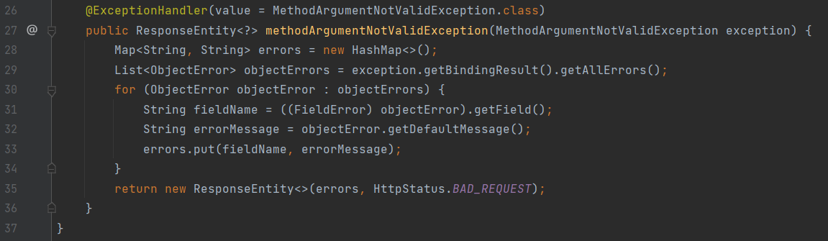
Bean Validation API
Controller Advice - MethodArgumentNotValidException.class

Slide 62
What is Spring Boot JPA?
- Spring Boot JPA is a Java specification for managing relational data in Java applications. It allows us to access and persist data between Java object/ class and relational database.
- JPA follows Object-Relation Mapping (ORM).
- It is a set of interfaces.
- It also provides a runtime EntityManager API for processing queries and transactions on the objects against the database.
- It uses a platform-independent object-oriented query language JPQL (Java Persistent Query Language).

Slide 63
Why should we use JPA?
- JPA is simpler, cleaner, and less labor-intensive than JDBC, SQL, and hand-written mapping.
- JPA is suitable for non-performance oriented complex applications.
- The main advantage of JPA over JDBC is that, in JPA, data is represented by objects and classes while in JDBC data is represented by tables and records.
- It uses POJO to represent persistent data that simplifies database programming.

Slide 64
JPA Implementations
- There are some popular JPA implementations frameworks such as Hibernate, EclipseLink, DataNucleus, etc.
- It is also known as Object-Relation Mapping (ORM) tool.

Slide 65
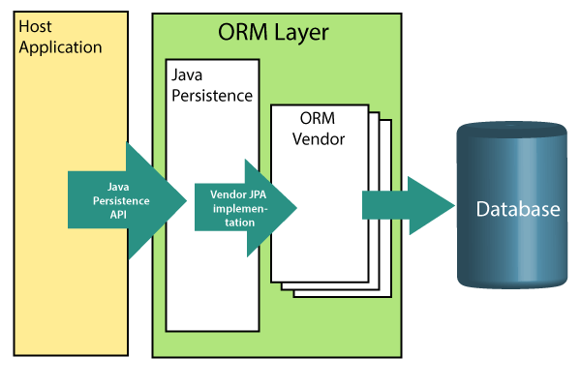
Object-Relation Mapping (ORM)
- In ORM, the mapping of Java objects to database tables, and vice-versa is called Object-Relational Mapping.
- The ORM mapping works as a bridge between a relational database (tables and records) and Java application (classes and objects).

Slide 66
Object-Relation Mapping (ORM)
- The ORM layer exists between the application and the database.
- It converts the Java classes and objects so that they can be stored and managed in a relational database.
- By default, the name that persists become the name of the table, and fields become columns.
- Once an application sets-up, each table row corresponds to an object.

Slide 67
Difference between JPA and Hibernate
JPA: JPA is a Java specification that is used to access, manage, and persist data between Java object and relational database. It is a standard approach for ORM.
Hibernate: It is a lightweight, open-source ORM tool that is used to store Java objects in the relational database system. It is a provider of JPA. It follows a common approach provided by JPA.

Slide 68
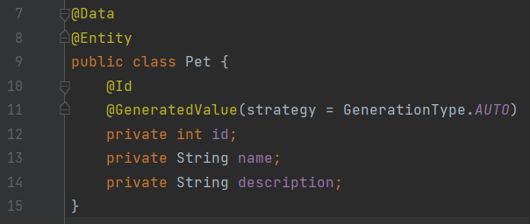
Spring Boot Data JPA
Entity Class

Slide 69
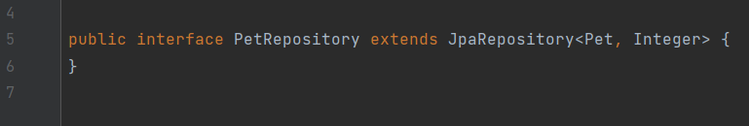
Spring Boot Data JPA
Repository / DAO Layer

Slide 70

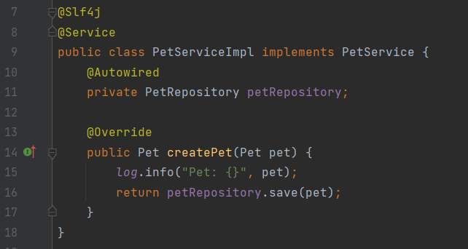
Spring Boot Data JPA
Service Layer

Slide 71
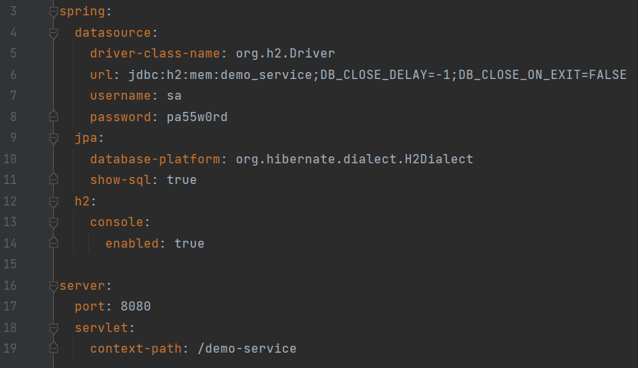
Spring Boot Data JPA
application.yml

Slide 72
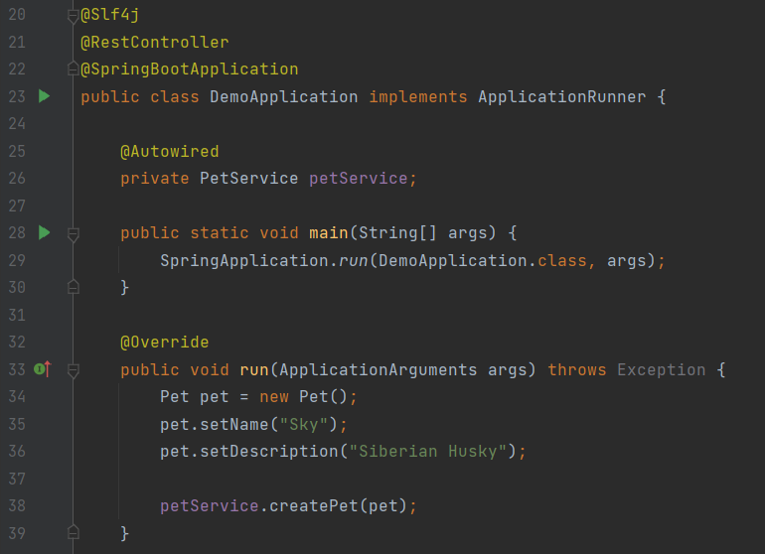
Spring Boot Data JPA
Let’s try to insert pet data via ApplicationRunner

Slide 73
Consuming Web Service

Slide 74
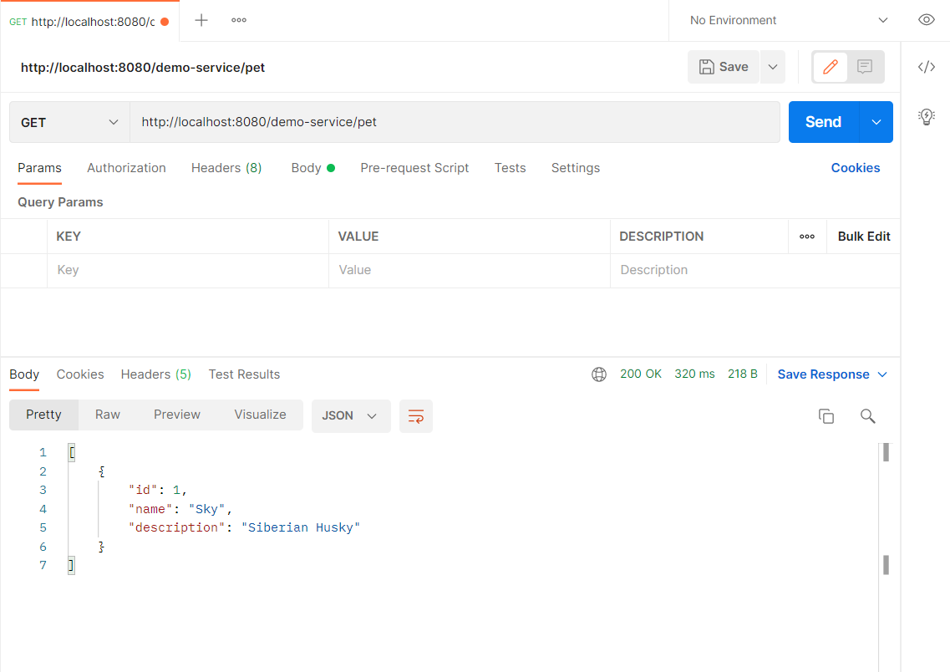
Via Postman - GET

Slide 75
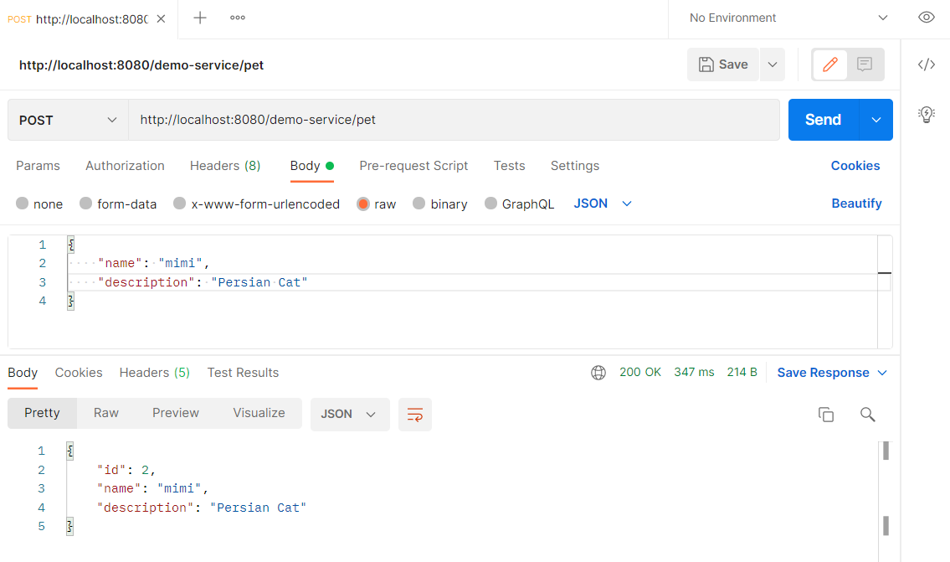
Via Postman - POST

Slide 76
JUnit

Slide 77
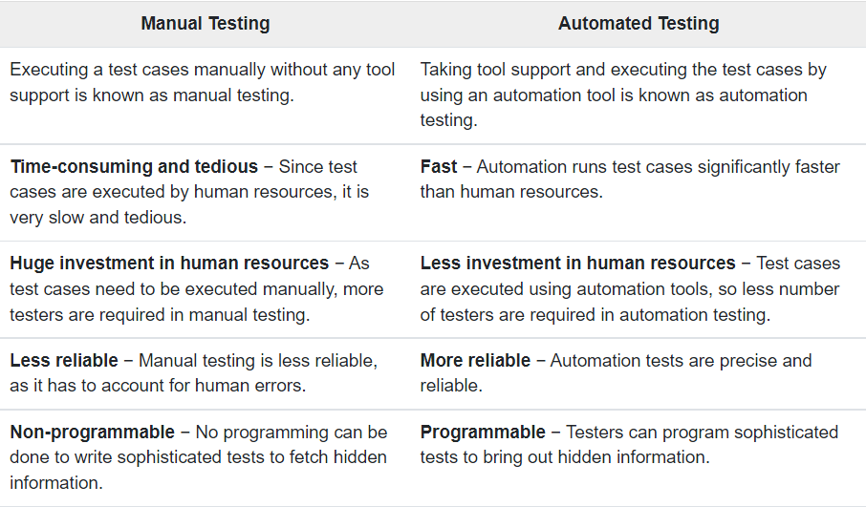
Manual Testing vs Automated Testing

Slide 78
What is JUnit?
- JUnit is a unit testing framework for Java programming language. It plays a crucial role test-driven development, and is a family of unit testing frameworks collectively known as xUnit.
- JUnit promotes the idea of "first testing then coding", which emphasizes on setting up the test data for a piece of code that can be tested first and then implemented. This approach is like "test a little, code a little, test a little, code a little." It increases the productivity of the programmer and the stability of program code, which in turn reduces the stress on the programmer and the time spent on debugging.

Slide 79
Features of JUnit
- JUnit is an open source framework, which is used for writing and running tests.
- Provides annotations to identify test methods.
- Provides assertions for testing expected results.
- Provides test runners for running tests.
- JUnit tests allow you to write codes faster, which increases quality.
- JUnit is elegantly simple. It is less complex and takes less time.
- JUnit tests can be run automatically and they check their own results and provide immediate feedback. There's no need to manually comb through a report of test results.
- JUnit tests can be organized into test suites containing test cases and even other test suites.
- JUnit shows test progress in a bar that is green if the test is running smoothly, and it turns red when a test fails.

Slide 80
Unit Testing vs Integration Testing
Unit testing means testing individual modules of an application in isolation (without any interaction with dependencies) to confirm that the code is doing things right.
Integration testing means checking if different modules are working fine when combined together as a group.

Slide 81
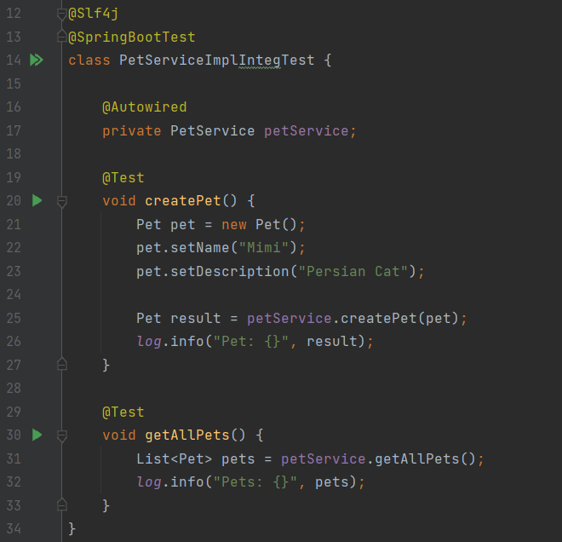
Integration Test

Slide 82
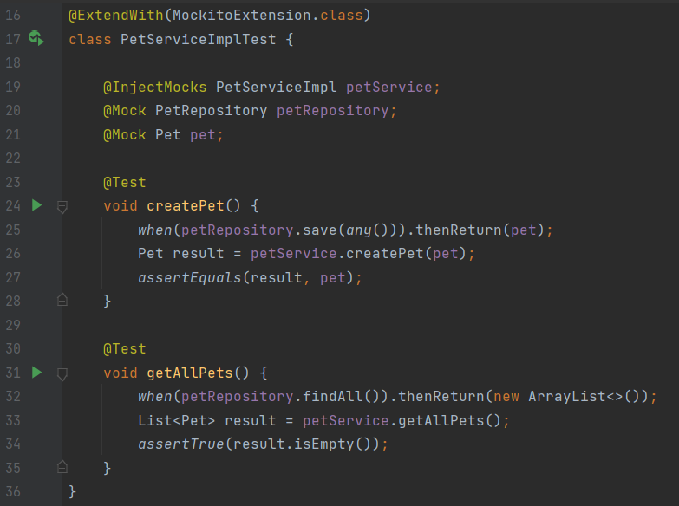
Unit Test
implementation 'org.springframework.boot:spring-boot-starter-validation'

Slide 83
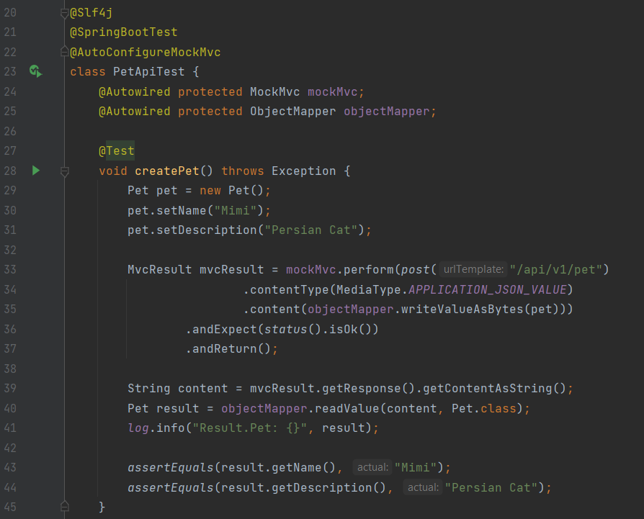
Integration Test - Controller

Slide 84
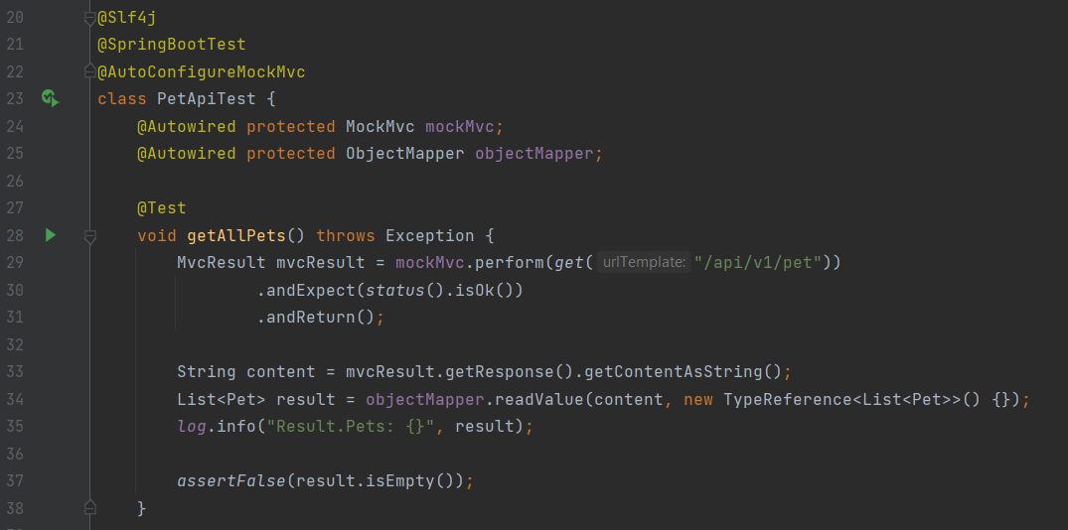
Integration Test - Controller

Slide 85
Thanks!
ANY QUESTIONS?
Email: houwaey@gmail.com

Slide 86
References
https://www.edureka.co/blog/what-is-microservices/
https://www.tutorialspoint.com/spring_boot/index.htm
https://www.javatpoint.com/spring-mvc-validation
https://www.baeldung.com/spring-boot-bean-validation
https://www.javatpoint.com/spring-boot-jpa
https://www.tutorialspoint.com/junit/index.htm

